Slide 1
Code Sample and Github Link

Slide 2
GitHub Link
Here is the github link of the project
https://github.com/csproject1/csproject1

Slide 3
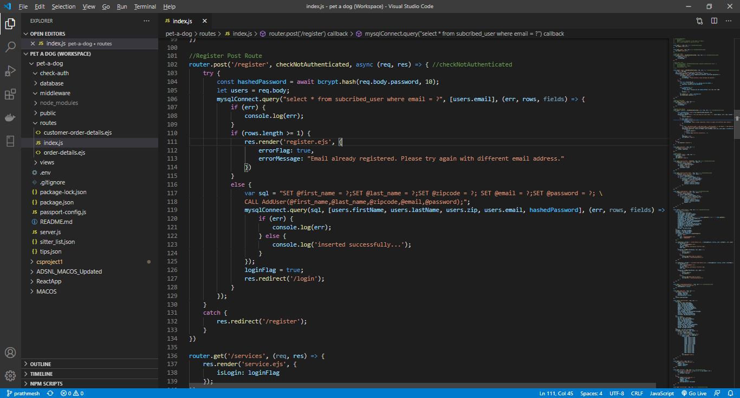
Github code screenshot and code samples

Slide 4
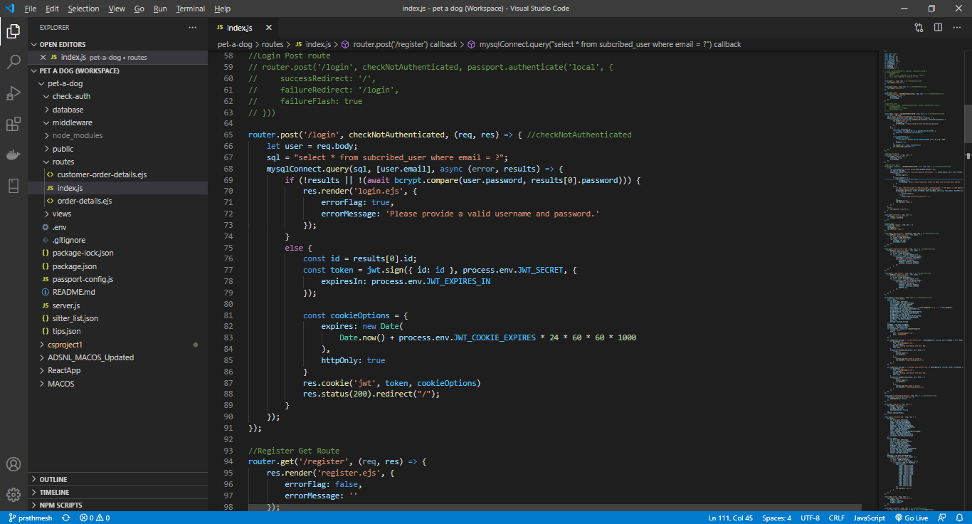

Slide 5
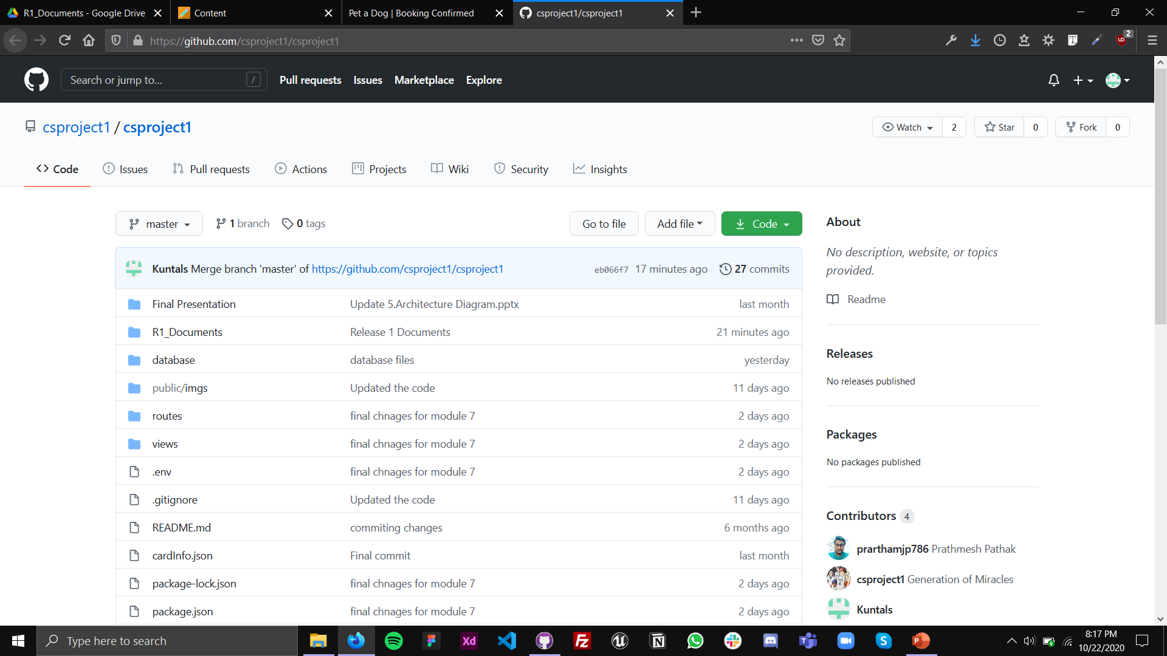

Slide 6
Steps for installation
Take the checkout of the project. Do npm install to get the dependencies. Run node server to start the server. In browser go to localhost:8000. You will see the Login screen. First you have to register with a valid email ID. After registration, login with your credentials. You will see the site's Home page and data that are listed there are static. There are 4 navigation options Home, Search Sitter, Our Services and Dog Care. Search sitter will show the list of sitters, again all the data that you see is static. Our services option is not implemented yet. Dog Care tab will show the necessary option to take care of your dog. Another section is the User's profile where user can see his details and also can enter the details about their dogs. One user can have multiple dogs user can enter N number of dog data. Information about a dog includes breed, age in years and month weight etc. All the information will be available on the user profile page. After this user have the option of logging out.

